Slide 1
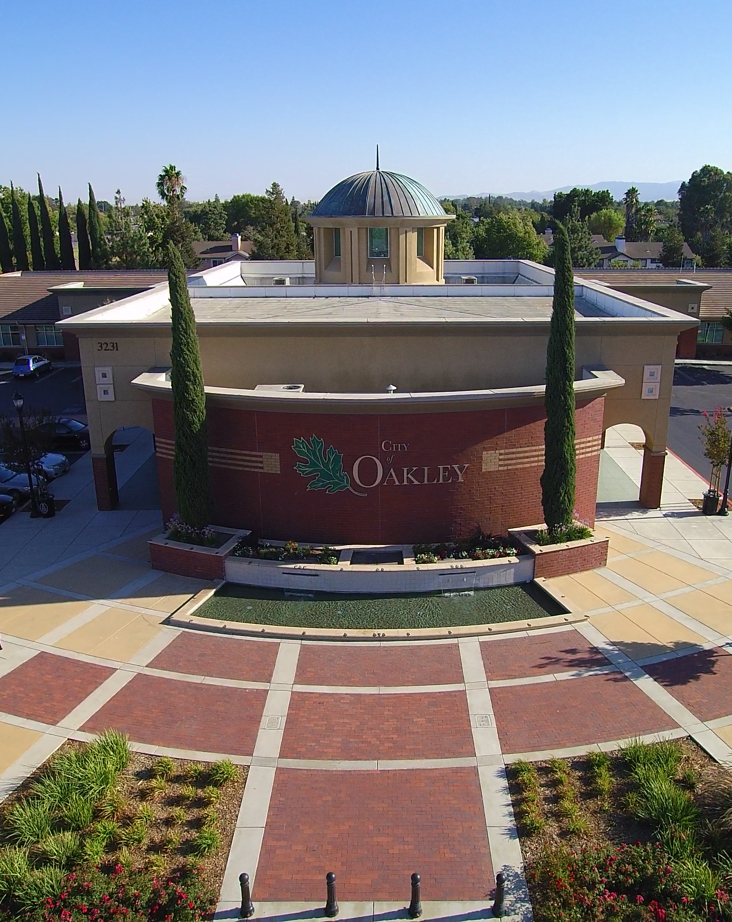

Focused General Plan Update
Status Report & Visioning Overview
City Council
September 10, 2019

Slide 2
Why is the General Plan Important?
Community Vision
The General Plan serves as the City’s ‘playbook’ for land use and planning decisions relative to:
    Land Uses (residential, commercial, industrial, business parks, open space, etc.)
    Infrastructure Planning (roads, water, sewer, etc.)
    Public Services (police, fire, parks, libraries, cultural activities, etc.)
    Resource Conservation (clean air, sensitive habitat, waterways, groundwater, etc.)
City staff, elected and appointed officials, business owners, developers, and citizens can reference the General Plan for guidance on what Oakley values and its priorities.

Slide 3
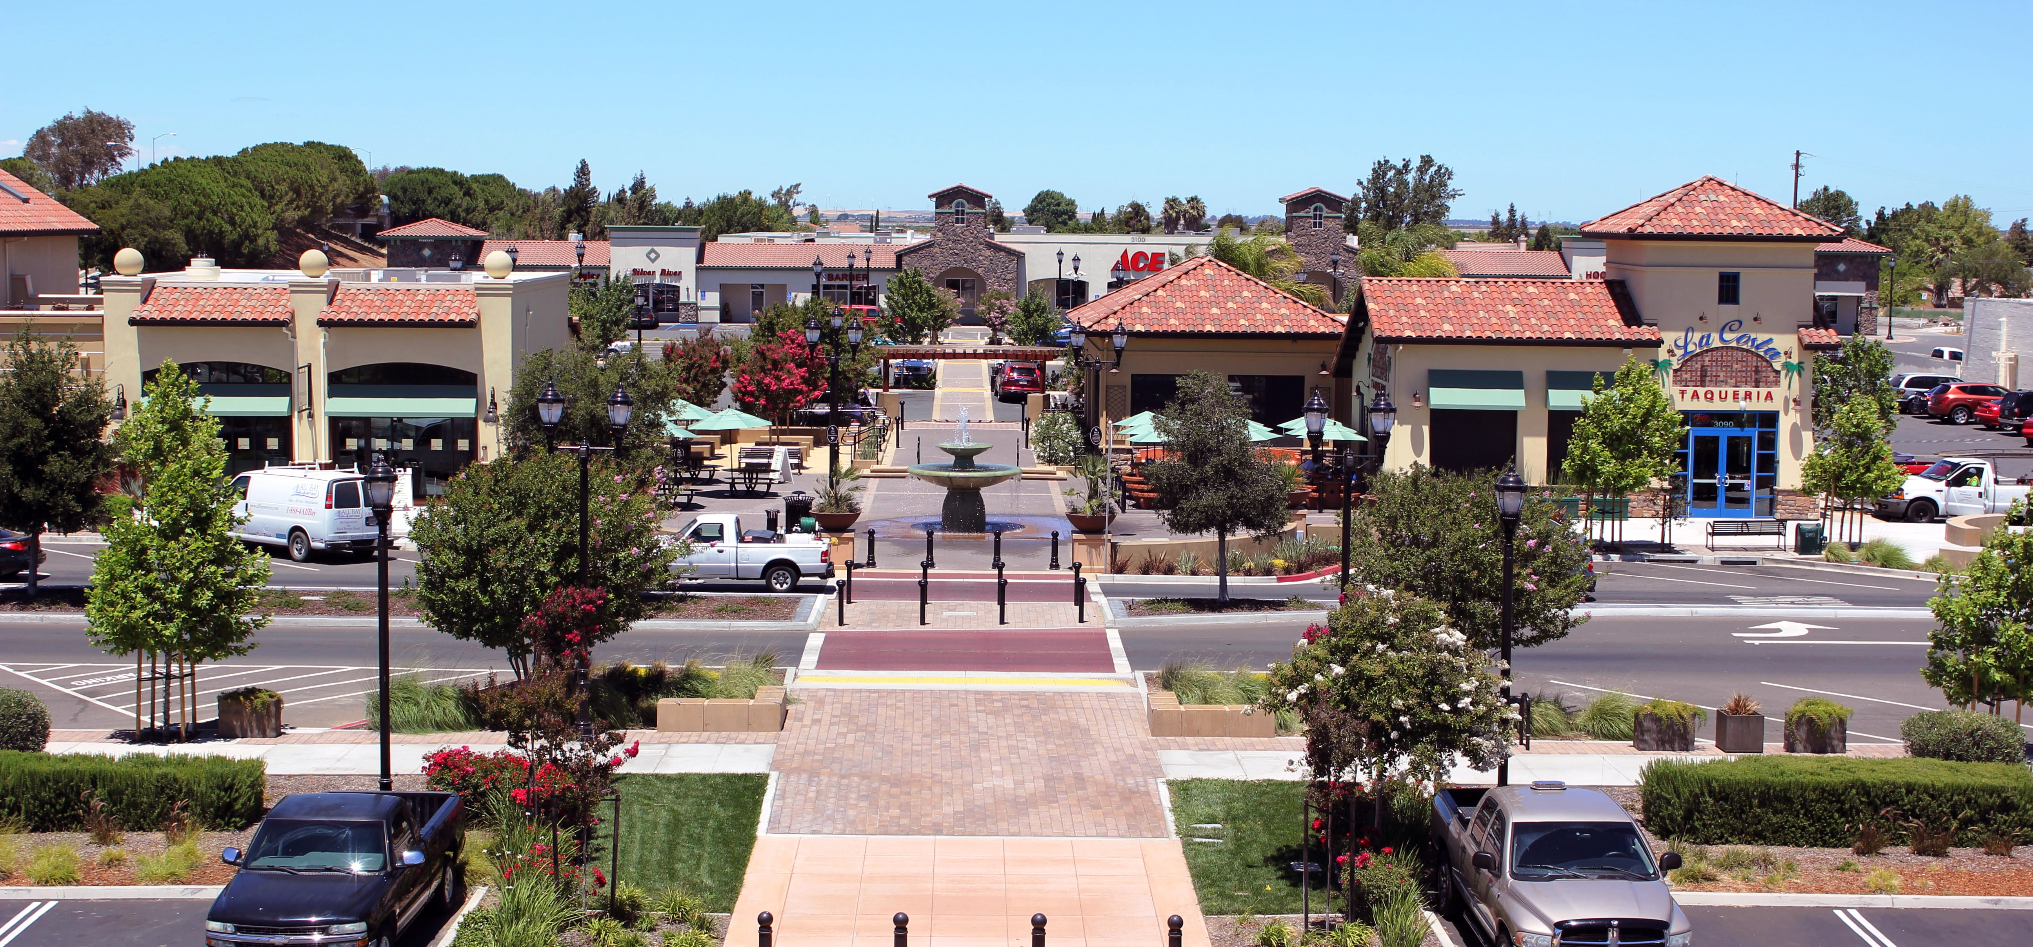
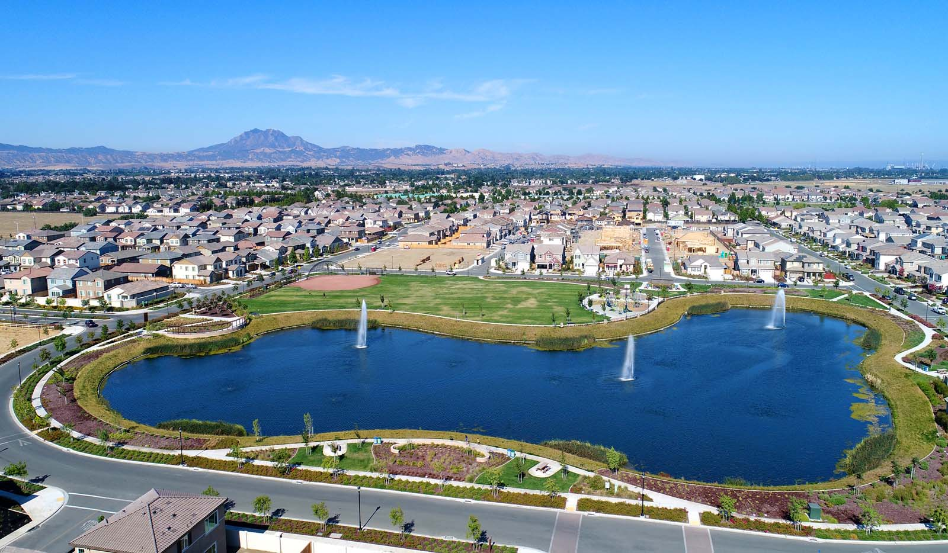
Why Do We Need an Update?
Opportunity to connect with the community to confirm values and goals
Build on past successes
Address State law, including new mobility, climate change, and environmental justice requirements
Reflect community priorities for growth, conservation, and quality of life

Slide 4
What is in a General Plan?
Required Topics
Optional Topics
Land Use
Circulation
Open Space
Conservation
Safety
Noise
Housing
Economic Development
Growth Management
Parks and Recreation

Slide 5

Process
Vision and Existing Conditions
Draft General Plan
CEQA and Final General Plan
Community Visioning
White Papers
  Vision & Opportunities
  Mobility
  Environmental Justice
  Climate Adaptation
City Council Work Sessions:
September through January 2020
  Vision: Focused Updates
  EJ & Climate Adaptation
  Mobility
Public Draft General Plan: Spring 2020
Initial Study/Negative Declaration
City Council Hearings: Late Spring/Summer 2020
Final General Plan

Slide 6
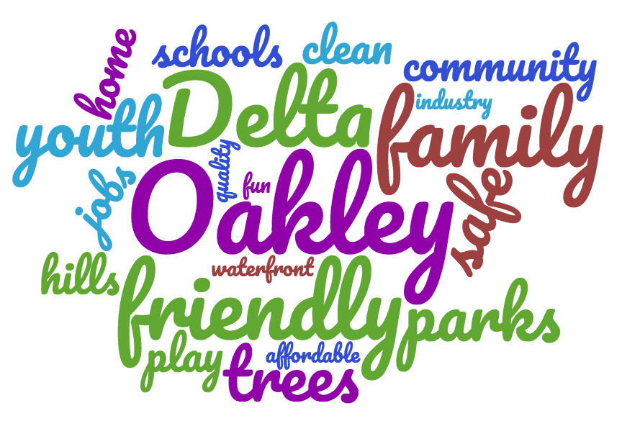
Visioning White Paper
Notes:
What we heard is summarized in a Visioning White Paper that was published in August

Slide 7
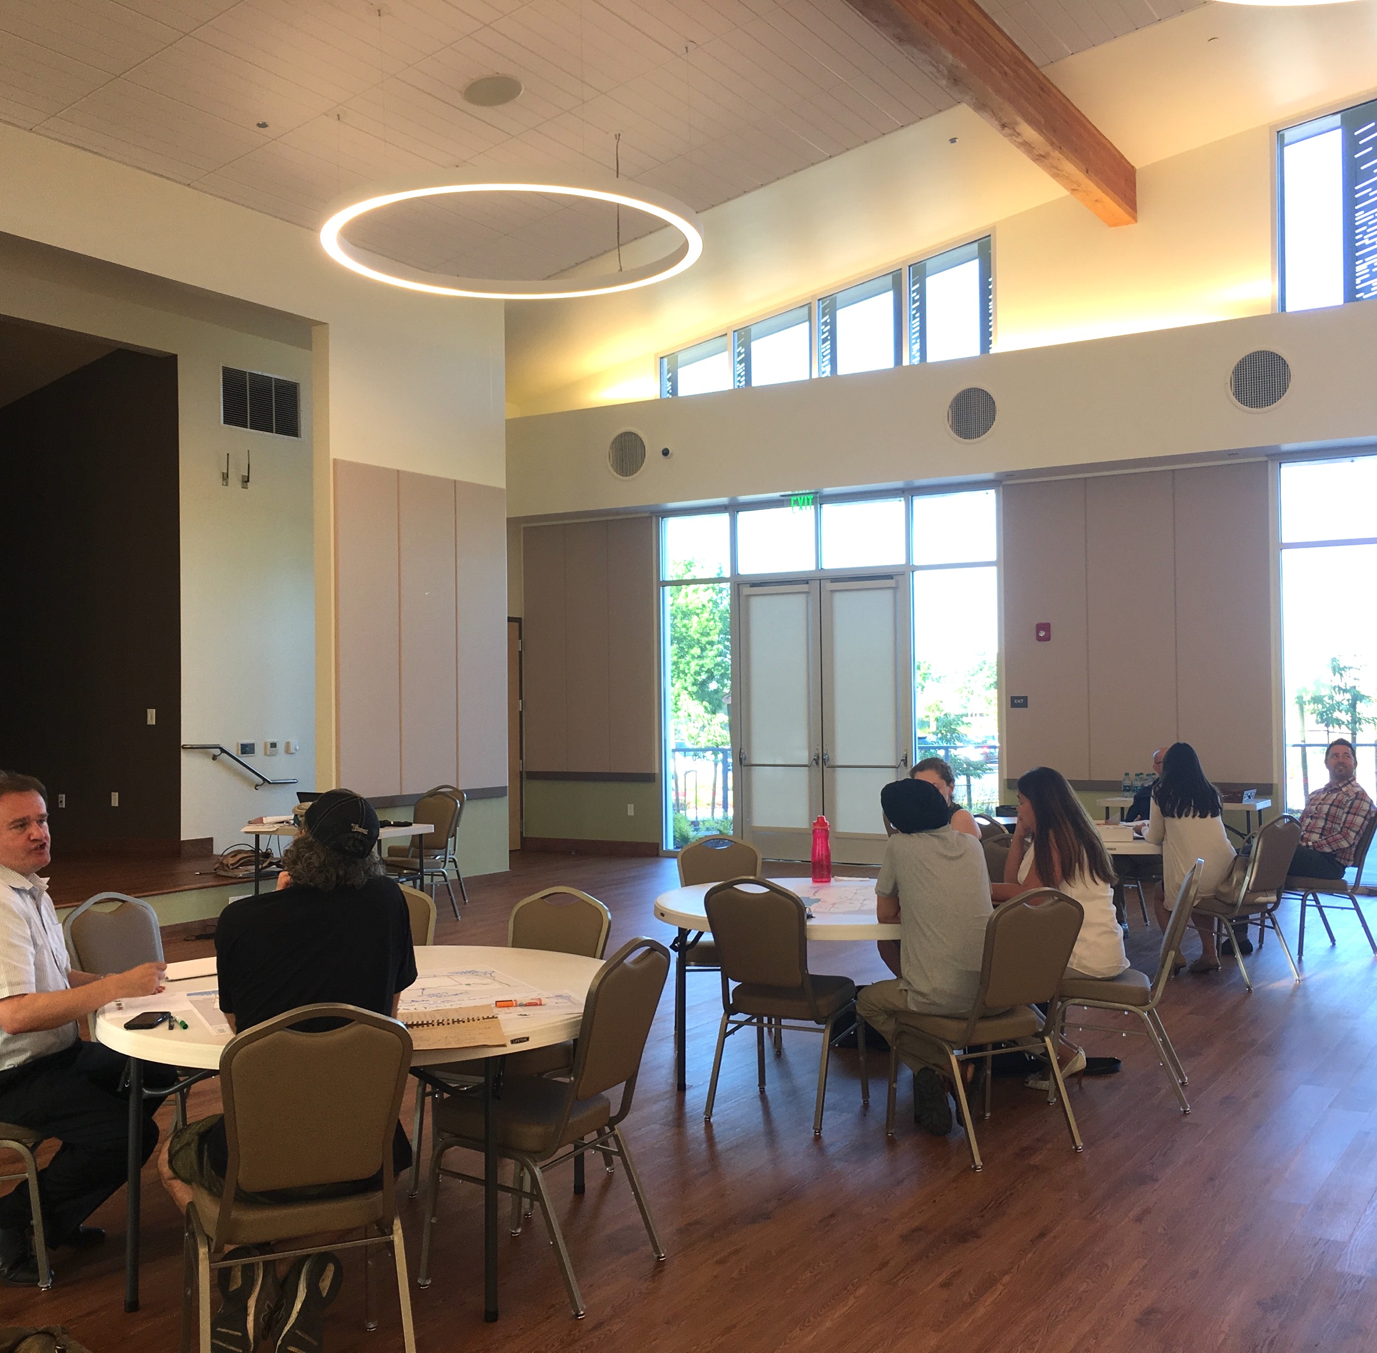
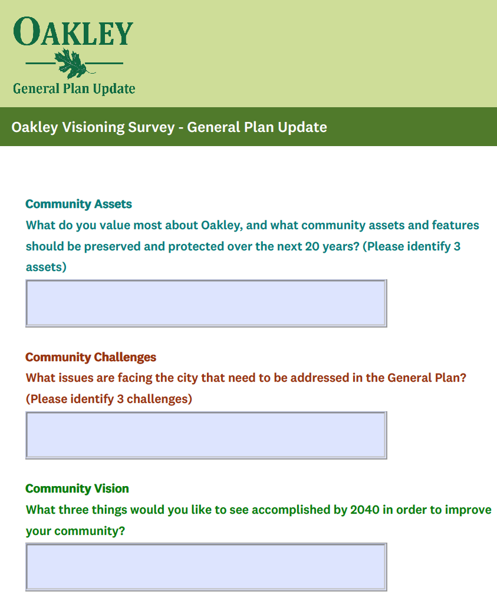
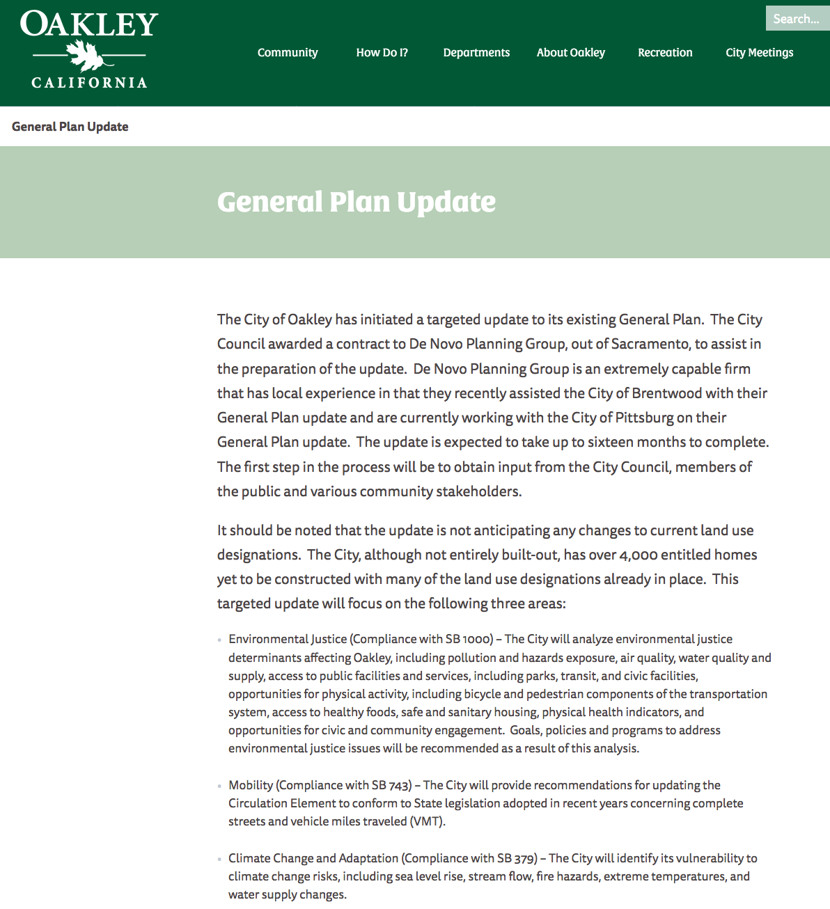
Visioning Outreach
Workshops
Survey
Website
Notes:
Two community workshops were held in June and a community survey was made available on-line and advertised at City Council meetings, on the website, and via social media

Slide 8
Community Input
Vision for Oakley, community assets, challenges for the General Plan to address
Circulation priorities, areas for attention, and needed improvements
Needs and solutions for areas through Oakley, with a focus on potential environmental justice concerns
Notes:
The “Visioning White Paper” highlights seven major takeaways from the outreach effort...
First, we found that Oakley takes great pride in its small-town, family-oriented community, the distinct downtown, and the range of natural resources that make Oakley unique, including the Delta, Big Break, agricultural, rural, and open space assets
For mobility, participants indicated that continuing to address vehicle traffic is important, but indicated that transportation-related improvements should focus on safety and improving pedestrian facilities and accessibility
People also stressed that Oakley needs high-quality jobs and an expanded economic base – technology sector, business parks, and commercial jobs that provide high-quality, well-paid jobs
A desire for more shopping, particularly grocery and community-serving stores, restaurants, and social venues that provide entertainment and family-oriented recreation opportunities, grocery stores, was identified by community members

Slide 9
Community Values and Priorities
Community character
Mobility
Economy/Local Jobs
Shopping and Services
Notes:
The “Visioning White Paper” highlights seven major takeaways from the outreach effort...
First, we found that Oakley takes great pride in its small-town, family-oriented community, the distinct downtown, and the range of natural resources that make Oakley unique, including the Delta, Big Break, agricultural, rural, and open space assets
For mobility, participants indicated that continuing to address vehicle traffic is important, but indicated that transportation-related improvements should focus on safety and improving pedestrian facilities and accessibility
People also stressed that Oakley needs high-quality jobs and an expanded economic base – technology sector, business parks, and commercial jobs that provide high-quality, well-paid jobs
A desire for more shopping, particularly grocery and community-serving stores, restaurants, and social venues that provide entertainment and family-oriented recreation opportunities, grocery stores, was identified by community members

Slide 10
Community Values and Priorities
Parks, Recreation, and Entertainment
Community Services and Resources
Managed Growth
Notes:
A desire parks, recreation, and a healthy and active lifestyle was demonstrated by the stated need for parks and continued improvements to parks, access to the waterfront, family-friendly events, and recreation and activity programs for all ages.
Community safety and community-oriented facilities and services, including a local library, improvements to schools, and family- and youth-oriented activities, were key concerns
identified during the Visioning process. An on-going commitment to a responsive police department and fire department and to proactive management of safety, homelessness, and crime is needed for residents to continue to feel safe.
Services and infrastructure must be planned to keep pace with growth, particularly housing, and new development should reflect the desired character of the community and respect the rural, open space, and
agricultural nature of the area.

Slide 11
General Plan Revisions
General Plan Element to be Reviewed/Updated | Community-Identified Priorities and Issues to be Addressed
Land Use | Review and revise land use designations as necessary in order to increase the amount of desirable retail and entertainment uses (i.e., grocery stores, restaurants, higher-quality and community-serving stores and brands, etc.) and to manage the amount of undesirable uses (i.e., storage facilities, liquor stores, etc.). Review and revise land use designations as necessary in order to encourage and attract needed community services. Note: The General Plan Update will not include increases to land use intensities or densities, but can refine the land use designation descriptions and associated policies to better reflect desires uses in the community.
Circulation | Review circulation plan to identify opportunities for road and street connections to improve vehicle travel and ensure neighborhoods and community areas are served by complete streets Review circulation goals and priorities to ensure that alternative transportation facilities (for walking, biking, and transit use) are improved and developed in needed areas, such as downtown.
Growth Management | Ensure that approach to infrastructure and mobility improvements and provision of community services keeps pace with pending and future development projects. Address public safety and crime rates by reviewing goals and policies related to police services.

Slide 12
General Plan Revisions
General Plan Element to be Reviewed/Updated | Community-Identified Priorities and Issues to be Addressed
Economic Development | Attract desirable retail and entertainment uses (i.e., grocery stores, restaurants, social venues, family-oriented entertainment, etc.) Provisions for industries to ensure that the City is attracting high-quality businesses and industries that provide well-paid and high-quality jobs, serve an educated workforce, and reflect new and emerging technologies Encourage economic development within the City so residents and workers do not have to travel to nearby cities for retail and entertainment opportunities.
Open Space and Conservation | Ensure that the open space, rural feel of the area is conserved and managed as development occurs. Encourage agricultural uses are encouraged and maintain appropriate locations for agriculture in the long-run. Ensure existing open space areas, including waterfront, are planned and managed to be accessible for recreation and for community gathering and events, where allowed.
Parks and Recreation | Ensure that the goals and policies address existing parks and community spaces (i.e., library), as well as future recreation needs (i.e., waterfront access).
Noise | Review and revise as necessary in order to address noise concerns within Focus Areas 1 and 2.

Slide 13
General Plan Update Schedule
City Council Kick-off/Visioning Workshops
May/June 2019
Vision & Opportunities White Paper
August 2019
Vision: Overall Update
White Paper/City Council Work Session #1
September 2019
Environmental Justice/Climate Change
White Paper/City Council Work Session #2
October 2019
Mobility
White Paper/City Council Work Session #3
December 2019
Admin. Draft General Plan
March 2020

