Slide 1
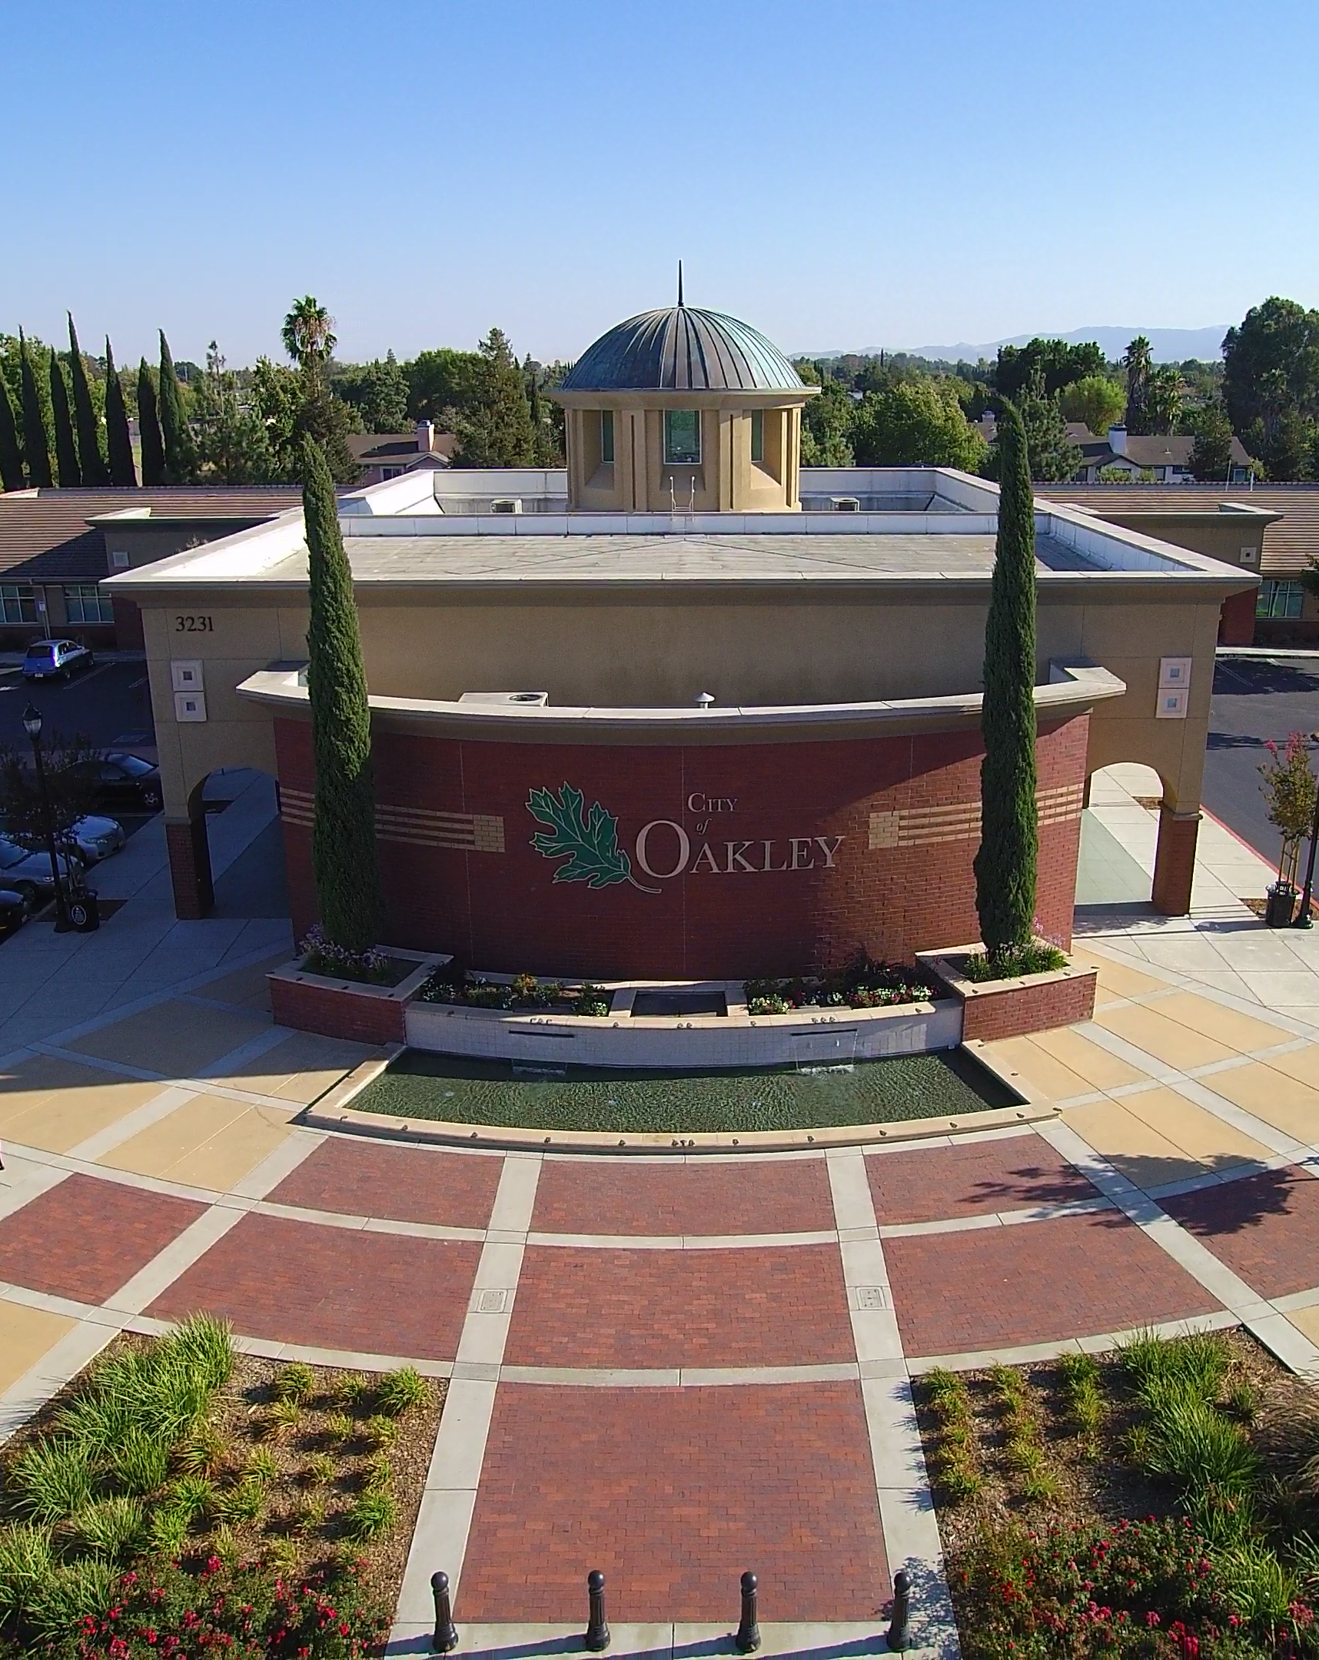

Focused General Plan Update
Environmental Justice &
Climate Adaptation
City Council
October 22, 2019

Slide 2

Process
Vision and Existing Conditions
Draft General Plan
CEQA and Final General Plan
Community Visioning
White Papers
  Vision & Opportunities
  Mobility
  Environmental Justice
  Climate Adaptation
City Council Work Sessions:
September through January 2020
  Vision: Focused Updates
  EJ & Climate Adaptation
  Mobility
Public Draft General Plan: Spring 2020
Initial Study/Negative Declaration
City Council Hearings: Late Spring/Summer 2020
Final General Plan

Slide 3
Environmental Justice White Paper
SB 1000 requires cities to address Environmental Justice (EJ) in their General Plans if they have "disadvantaged communities” or DACs:
"An area identified by the California Environmental Protection Agency (CalEPA) pursuant to Section 39711 of the Health and Safety Code or an area that is a low-income area that is disproportionately affected by environmental pollution and other hazards that can lead to negative health effects, exposure, or environmental degradation."

Slide 4
Environmental Justice Topics
Each General Plan must address the following topics related to environmental justice:
Pollution Exposure and Air Quality
Public Facilities
Food Access
Safe and Sanitary Homes
Physical Activity
“Civil” or Community Engagement
Improvements and Programs that address the needs of Disadvantaged Communities

Slide 5
Disadvantaged Communities

Slide 6
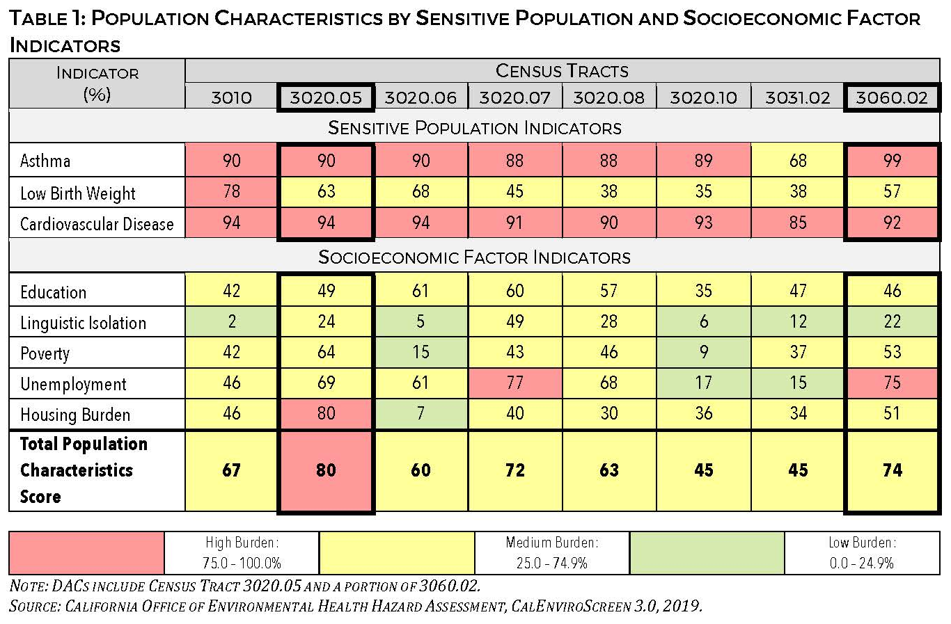
Population Characteristics

Slide 7
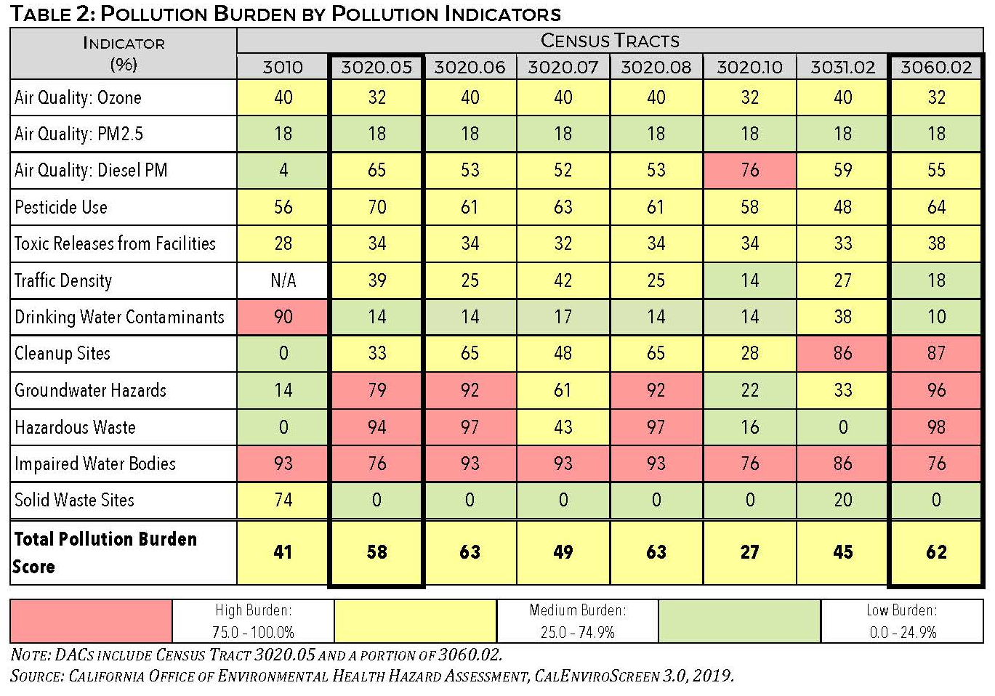
Pollution Indicators

Slide 8
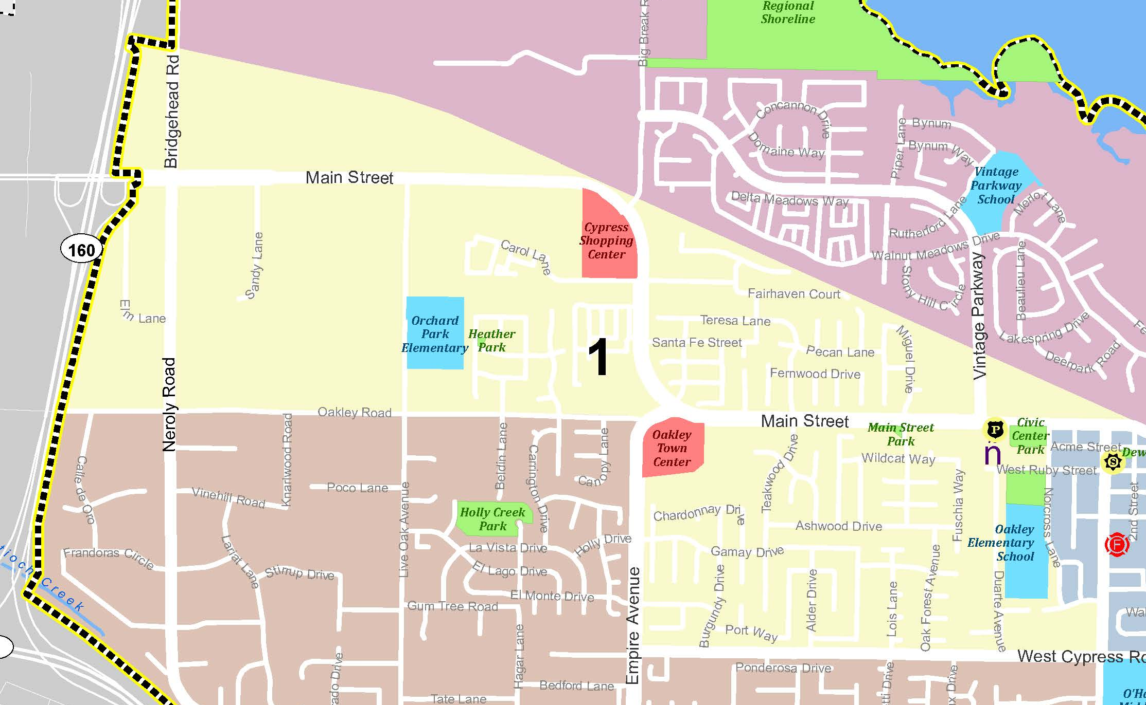
Community Input – Focus Area 1
Top concerns for this area:
Lack of community services
Noise
Access to affordable and nutritious food
Need for aesthetic improvements
Lack of safe and affordable housing
Disparity between subareas
Top needs for this area:
Public safety
Public facilities
Parks and recreation
Safe and affordable housing
Maintenance and renovation
Notes:
Two community workshops were held in June and a community survey was made available on-line and advertised at City Council meetings, on the website, and via social media

Slide 9
General Plan Approach
Topic | Potential General Plan Policies and Actions
Land Use and Planning (Pollution Exposure, Air Quality) | Require future planning decisions, development, and infrastructure and public projects to consider the effects of planning decisions on the overall health and well-being of the community and its residents, with specific consideration provided regarding disadvantaged populations and communities to ensure equitable distribution of amenities, needed infrastructure, and community services and to avoid concentrations of adverse uses in DACs. As part of land use decisions, ensure that environmental justice issues related to potential adverse health impacts associated with land use decisions, including methods to reduce exposure to hazardous materials, industrial activity, vehicle exhaust, other sources of pollution, and excessive noise on residents regardless of age, culture, gender, race, socioeconomic status, or geographic location, are considered and addressed. Locate site entries, parking areas, storage bays, and service areas of buildings to minimize conflicts with adjacent properties, especially residential neighborhoods. Encourage smoke free workplaces, multifamily housing, parks, and other outdoor gathering places to reduce exposure to secondhand smoke. Review all development proposals, planning projects, and infrastructure projects to ensure that potential adverse impacts to disadvantaged communities, such as exposure to pollutants, including toxic air contaminants, and unacceptable levels of noise and vibration are reduced to the extent feasible and that measures to improve quality of life are included.

Slide 10
General Plan Approach
Topic | Potential General Plan Policies and Actions
Community Services and Facilities (Physical Activity) | When planning for parks, recreational facilities, community gardens, civic facilities, and other uses that improve the quality of life, ensure that environmental justice issues related to the equitable provision of desirable public amenities are considered and addressed. Support existing health care services and encourage the location of new health care facilities and medical services, particularly in disadvantaged areas, areas with a high rate of special needs populations, and in underserved residential areas. Encourage the County to promote physical activity, access to healthy food, and address health indicators in local DACs through the Healthy Communities Program. Encourage community gardens near high-density housing and encourage the incorporation of community gardens into new and existing high-density housing projects. Encourage schools that serve the City to develop school gardens and to develop protocols to facilitate the streamlined development of school gardens from year to year.
Food Access | Encourage convenience stores, supermarkets, liquor stores, and neighborhood markets to stock nutritional food choices, including local produce, local meats and dairy, 100% juices, and whole-grain products. Encourage sustainable local food systems including farmer’s markets, community gardens, edible school yards, community supported agriculture, neighborhood garden exchanges, federal food assistance programs, and healthy food retailers. Support schools and other organizations’ efforts to encourage students and their families to make healthy food choices through providing fresh, nutritious lunches and providing students and their families access to fresh fruits and vegetables through “edible school yards”, holiday meal programs, and sustainable gardening programs.

Slide 11
General Plan Approach
Topic | Potential General Plan Policies and Actions
Safe and Sanitary Homes | Housing Element
Circulation (Physical Activity) | Update policies and plans to maximize the benefit to the public of new transportation technologies and services without adversely affecting the City’s transportation network. Consider implementing vehicle weight limit restrictions on roadways near sensitive uses like schools and residential neighborhoods to discourage cut-through truck traffic. Encourage and support local transit service providers to increase and expand services for people who are transit-dependent, including seniors, persons with mobility disabilities, and persons without regular access to automobiles, by improving connections to regional medical facilities, senior centers, and other support systems that serve residents and businesses. Review updates to transportation planning documents and any automated vehicle plans to ensure the benefits of automated mobility are equitably distributed across all segments of the community and that the negative impacts are not disproportionately borne on traditionally marginalized neighborhoods. As part of the development of or participation in any ridesharing program, including for shared automated vehicle fleets, ensure that the program considers the safety needs of vulnerable populations and loading needs of seniors, families with children, and individuals with mobility impairments.
Civic Engagement | Promote broad and balanced participation to ensure that affected residents have the opportunity to participate in the decision-making process, including in decisions that affect their health and well-being. Review the City’s community outreach programs and public notice requirements to encourage broad-based and meaningful community participation in decisions. The review should address providing measures to promote capacity-building, encourage participation from populations that may have language, health, or other barriers that may reduce their involvement in the decision-making process, and maximize use of technology broaden opportunities for participation.

Slide 12
Climate Adaptation White Paper
Government Code Section 65302 requires General Plans to address climate adaptation and resiliency strategies applicable to the city or county and to provide a vulnerability assessment that identifies the risks that climate change poses to the local jurisdiction.
Notes:
What we heard is summarized in a Visioning White Paper that was published in August

Slide 13
Climate Adaptation and Resiliency
In addressing climate change, the General Plan must include goals, policies, and measures to address:
Feasible methods to avoid or minimize climate change impacts associated with new uses of land.
Location, when feasible, of new essential public facilities outside of at-risk areas or identifying methods to minimize damage if these facilities are located in at-risk areas.
Designation of adequate and feasible infrastructure located in an at-risk area.
Guidelines for working cooperatively with relevant local, regional, state, and federal agencies.
Natural infrastructure and ecosystem processes that may be used in adaptation projects.
Notes:
What we heard is summarized in a Visioning White Paper that was published in August

Slide 14
Potential Effects of Climate Change
Rising ocean levels and warmer ocean
Changes to precipitation patterns
Increase in extreme heat days per year from 4 to 21 (2070 to 2099)
Changing temperatures, water levels, and flooding could result in:
  Increased flooding
  Salinity intrusion
  Less reliable water supply
  Increase in public health concerns (mortality and illness) related to air pollution, extreme heat, increased vector-born illnesses
  Reduction in suitable habitat for special-status species
Notes:
What we heard is summarized in a Visioning White Paper that was published in August

Slide 15
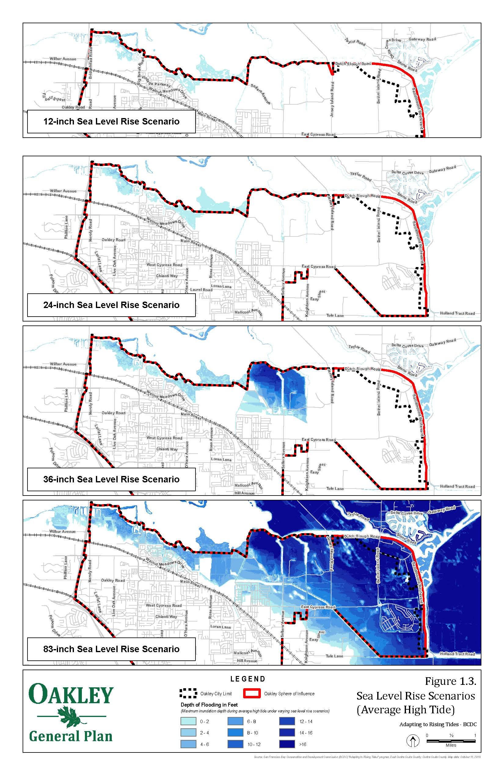
Sea Level Rise
BCDC Scenario – Average High Tide
Notes:
What we heard is summarized in a Visioning White Paper that was published in August

Slide 16
General Plan Approach
Topic | Potential General Plan Policies and Actions
Reduce Greenhouse Gas Emissions | Require development, infrastructure, and long-range planning projects to support State and local climate goals by demonstrating consistency with State GHG reduction targets and BAAQMD thresholds for GHG emissions. Promote a sustainable economy that encourages businesses to operate in an environmentally sound and community-friendly manner and that attracts and retains business sectors that support clean and sustainable technologies. Participate, when appropriate, in efforts of local and regional governments to identify programs that may assist Oakley and the region in reducing GHG emissions and in developing mitigation approaches. Examples of programs may include the Bay Area Regional Energy Network (BayREN) and Energy Upgrade California. Encourage and support for infill, mixed use, and higher density development, where appropriate, in order to reduce GHG emissions associated with vehicle travel. Consider opportunities to enhance existing water efficiency and conservation measures, as feasible, and continue to support programs that encourage recycled water use and water efficiency in order to reduce energy and GHGs associated with water use. Provide education and outreach highlighting the benefits of energy conservation to the community and encourage residents and businesses to utilize available PG&E, BAAQMD, and other programs to retrofit structures and upgrade appliances and equipment to reduce emissions. Explore methods to increase alternative energy production and consider establishing City-wide measurable goals for alternative energy. Where appropriate, remove regulatory or procedural barriers to producing renewable energy in the City’s Municipal Code. Consider opportunities to reduce urban heat islands through vegetation management and cool/higher-albedo surfaces.

Slide 17
General Plan Approach
Topic | Potential General Plan Policies and Actions
Plan for and Adapt to Climate Change Effects | Regularly update the City’s Emergency Operations Plan, as required by state and federal laws, and ensure that the plan addresses emergency situations, such as flooding, wildfires, and extreme temperature days, that may result from the changing climate. Ensure that updates to the Local Hazard Mitigation Plan address anticipated and modeled effects of climate change, including sea level rise, potential changes to areas affected by the 100-year storm event under sea level rise scenarios, extreme weather events, increased wildfire potential, and drought conditions. Provide developers with links to the CalAdapt and BCDC model data identifying sea level rise anticipated under potential climate change scenarios to ensure that all scenarios are considered in the design of future projects. Require new development projects located along the shoreline or in areas projected to be inundated under sea level rise scenarios to identify projected sea level rise levels in relation to proposed residences, buildings, and important infrastructure. Where new development or redevelopment projects are in areas projected to be substantially affected by increased sea levels or expanded 100-year flood areas, identify potential mitigation and adaptation measures prior to approval of development projects to address exposure to substantial flooding hazards during the useful life of structures. Monitor BCDC and other regional efforts to adapt to climate change and identify opportunities for participation in strategies and projects, including levees, seawalls, and other shoreline protection measures, to protect critical developed areas along the shoreline from flooding and by identifying opportunities to enhance natural resources, including preserving existing habitat, creek corridors, riparian areas, and the shoreline, reducing shoreline erosion, restoring habitat, and identifying areas where tidal wetlands can migrate landward. Maintain improvements and facilities designed to protect against flooding and sea level rise.

Slide 18
General Plan Approach
Topic | Potential General Plan Policies and Actions
Plan for and Adapt to Climate Change Effects | Regularly update the City’s Emergency Operations Plan, as required by state and federal laws, and ensure that the plan addresses emergency situations, such as flooding, wildfires, and extreme temperature days, that may result from the changing climate. Ensure that updates to the Local Hazard Mitigation Plan address anticipated and modeled effects of climate change, including sea level rise, potential changes to areas affected by the 100-year storm event under sea level rise scenarios, extreme weather events, increased wildfire potential, and drought conditions. Provide developers with links to the CalAdapt and BCDC model data identifying sea level rise anticipated under potential climate change scenarios to ensure that all scenarios are considered in the design of future projects. Require new development projects located along the shoreline or in areas projected to be inundated under sea level rise scenarios to identify projected sea level rise levels in relation to proposed residences, buildings, and important infrastructure. Where new development or redevelopment projects are in areas projected to be substantially affected by increased sea levels or expanded 100-year flood areas, identify potential mitigation and adaptation measures prior to approval of development projects to address exposure to substantial flooding hazards during the useful life of structures. Monitor BCDC and other regional efforts to adapt to climate change and identify opportunities for participation in strategies and projects, including levees, seawalls, and other shoreline protection measures, to protect critical developed areas along the shoreline from flooding and by identifying opportunities to enhance natural resources, including preserving existing habitat, creek corridors, riparian areas, and the shoreline, reducing shoreline erosion, restoring habitat, and identifying areas where tidal wetlands can migrate landward. Maintain improvements and facilities designed to protect against flooding and sea level rise.

Slide 19
General Plan Update Schedule
City Council Kick-off/Visioning Workshops
May/June 2019
Vision & Opportunities White Paper
August 2019
Vision: Overall Update
White Paper/City Council Work Session #1
September 2019
Environmental Justice/Climate Change
White Paper/City Council Work Session #2
October 2019
Mobility
White Paper/City Council Work Session #3
December 2019/ January 2020
Admin. Draft General Plan
March 2020

